Slide 1
Application Deployment
WorkshopPlus – Kubernetes Tech Briefing

Slide 2
Conditions and terms of use
© Microsoft Corporation. All rights reserved.
You may use these training materials solely for your personal internal reference and non-commercial purposes. You may not distribute, transmit, resell or otherwise make these training materials available to any other person or party without express permission from Microsoft Corporation. URL’s or other internet website references in the training materials may change without notice. Unless otherwise noted, any companies, organizations, domain names, e-mail addresses, people, places and events depicted in the training materials are for illustration only and are fictitious. No real association is intended or inferred. THESE TRAINING MATERIALS ARE PROVIDED “AS IS”; MICROSOFT MAKES NO WARRANTIES, EXPRESS OR IMPLIED IN THESE TRAINING MATERIALS¹

Slide 3

Learning Units covered in this Module
 | DevOps and GitOps
 | Continuous Integration Pipeline with Kubernetes
 | Continuous Delivery Pipeline with Kubernetes

Slide 4
Objectives
After completing this Learning, you will be able to:
Understand….
The concepts of DevOps and GitOps
Source code repo structure
CI/CD workflow using GitHub
Authentication and authorization

Slide 5
DevOps

Slide 6
What is DevOps? People. Process. Products.
DevOps is the union of people, process, and products to enable continuous delivery of value to your end users.
This training modules covers only basic functionality of tools like Azure DevOps and GitHub.
Please refer to our other Microsoft DevOps workshops for more details.
Develop
DevOps
Operate
Deliver

Slide 7
What is GitOps?
GitOps is an operational framework that takes DevOps best practices used for application development such as version control, collaboration, compliance, and CI/CD, and applies them to infrastructure automation.
GitOps uses a Git repository as the single source of truth for infrastructure definitions.
GitOps automates infrastructure updates using a Git workflow with continuous integration (CI) and continuous delivery (CD).

Slide 8

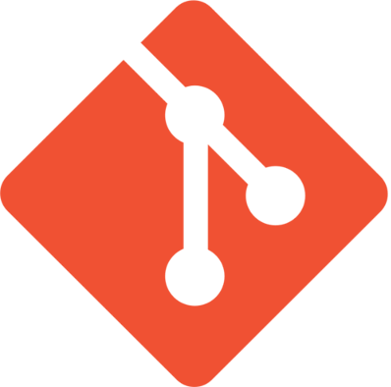
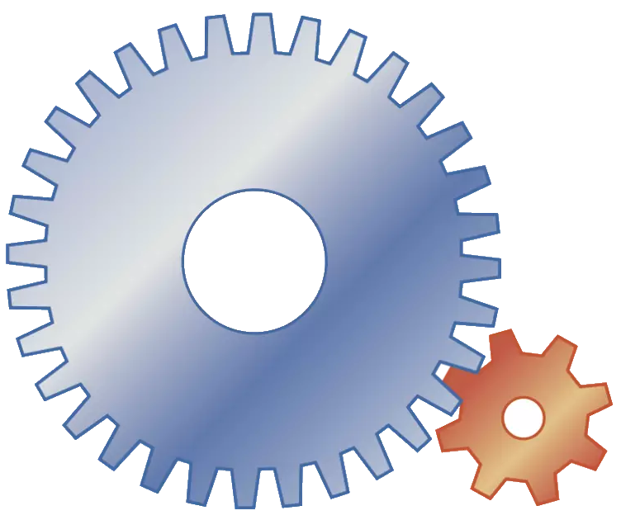
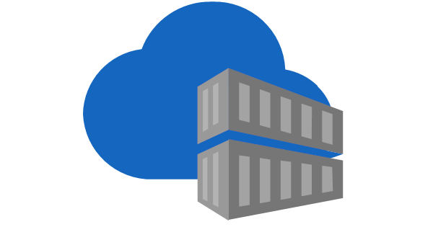
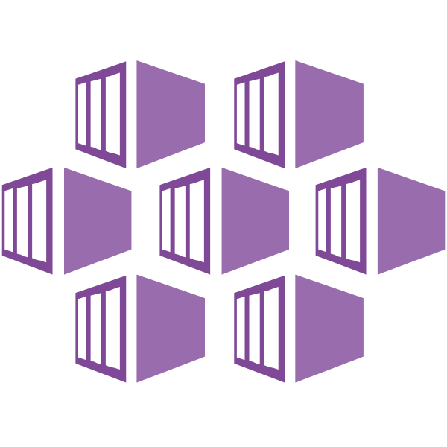
DevOps vs GitOps
DevOps uses pipelines that Push changes to a destination cluster.
GitOps monitors a Git repo and Pulls changes from the Git repo to synchronize a destination cluster.
Triggers on
Check-in or Pull Request
Dev
Dev
Dev
Dev
Dev
Helm Upgrade
Dev
Source Code
Git Repo
CD Release Pipeline
CI Build Pipeline
Container Registry
AKS
Monitors for changes
GitOps monitors repo
Applies Manifest or Helm Charts
Dev
Dev
Dev
Dev
Dev
Dev
Source Code
Git Repo
Build Image
Container Registry
AKS

Slide 9
Repository Structure
Application Repo
  Application code resides here and Dockerfiles
  Image building and pushing occurs here to ACR
Deployment
  Ideally a separate repo at a minimum can be a mono repo structure or polyrepo
  Mono repo
    Good for small projects with not a lot of environments
    Can be harder to scale as projects grow
    If using GitOps creates slower deployments by the GitOps Agents
  Polyrepos
    Multiple repos per service used in deployments

Slide 10
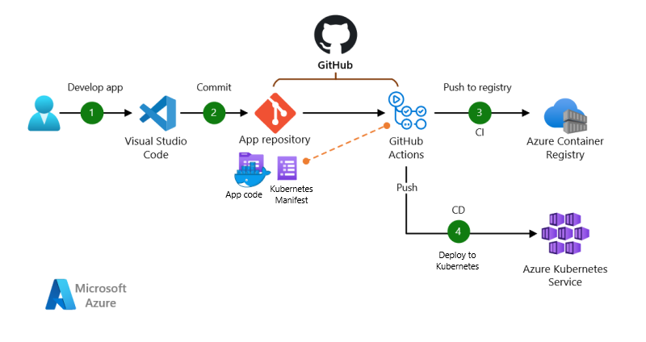
Git Hub CICD - Push
Notes:
CI/CD for AKS apps with GitHub Actions and GitFlow - Azure Example Scenarios | Microsoft Learn

Slide 11
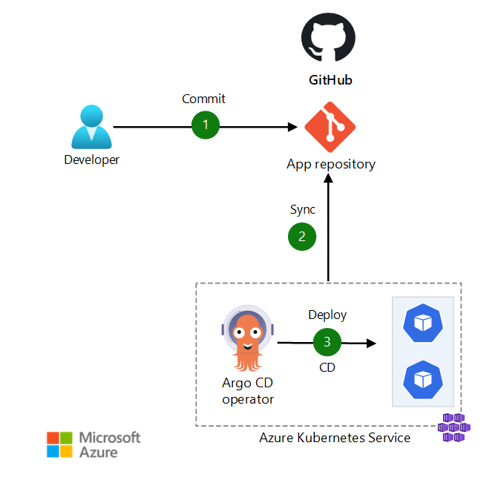
Git Hub CICD – Pull
Notes:
The Kubernetes administrator makes configuration changes in YAML files and commits the changes to the GitHub repository.
Argo CD pulls the changes from the Git repository.
Argo CD reconciles the configuration changes to the AKS cluster.

Slide 12
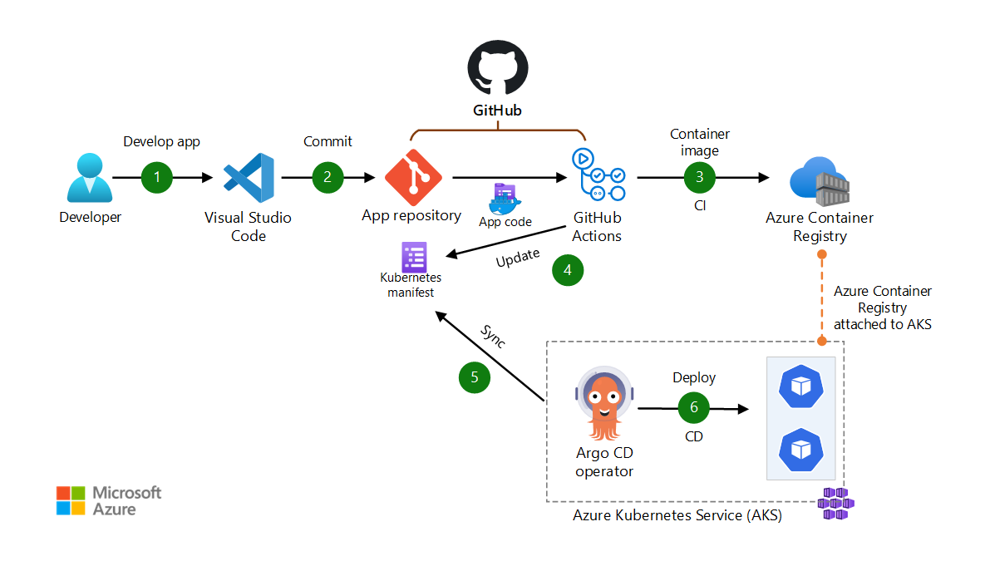
Git Hub CICD – Pull
Notes:
The app code is developed by using an IDE such as Visual Studio Code.
The app code is committed to a GitHub repository.
GitHub Actions builds a container image from the app code and pushes the container image to Azure Container Registry.
GitHub Actions updates a Kubernetes manifest deployment file with the current image version that's based on the version number of the container image in Azure Container Registry.
Argo CD pulls from the Git repository.
Argo CD deploys the app to the AKS cluster.
Pull vs Push
Large scale
Semi disconnected

Slide 13
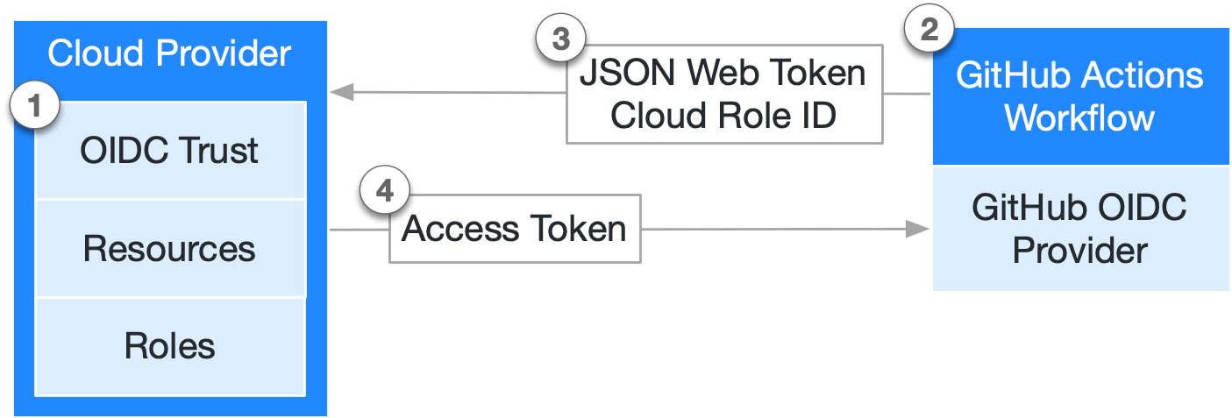
Git Hub Federate Identity
Notes:
In your cloud provider, create an OIDC trust between your cloud role and your GitHub workflow(s) that need access to the cloud.
Every time your job runs, GitHub's OIDC Provider auto-generates an OIDC token. This token contains multiple claims to establish a security-hardened and verifiable identity about the specific workflow that is trying to authenticate.
You could include a step or action in your job to request this token from GitHub's OIDC provider, and present it to the cloud provider.
Once the cloud provider successfully validates the claims presented in the token, it then provides a short-lived cloud access token that is available only for the duration of the job.
https://learn.microsoft.com/en-us/entra/workload-id/workload-identity-federation

Slide 14
OIDC Authenticate Azure from GitHub Action
Adding the federated credentials to Azure
Updating your GitHub Actions workflow
Adding permissions settings
Requesting the access token
Notes:
Adding the federated credentials to Azure
Create an Entra ID application and a service principal.
Add federated credentials for the Entra ID application.
Create GitHub secrets for storing Azure configuration.
Updating your GitHub Actions workflow yml file
Add permissions settings for the token.
Use the azure/login action to exchange the OIDC token (JWT) for a cloud access token.
Adding permissions settings – Sample in yml file using permission key word
permissions: id-token: write # This is required for requesting the JWT
contents: read # This is required for actions/checkout
Requesting the access token – use azure/login action. See the sameple yml. The Client_ID, TENANT_ID and SUB_ID should be set up in Step 1
name: Run Azure Login with OIDC
on: [push]
permissions:
id-token: write
contents: read
jobs:
build-and-deploy:
runs-on: ubuntu-latest
steps:
- name: 'Az CLI login'
uses: azure/login@a1b2c3d4e5f6a7b8c9d0e1f2a3b4c5d6e7f8a9b0
with:
client-id: ${{ secrets.AZURE_CLIENT_ID }}
tenant-id: ${{ secrets.AZURE_TENANT_ID }}
subscription-id: ${{ secrets.AZURE_SUBSCRIPTION_ID }}
- name: 'Run az commands'
run: |
az account show
az group list
https://learn.microsoft.com/en-us/azure/developer/github/connect-from-azure-openid-connect
https://docs.github.com/en/actions/security-for-github-actions/security-hardening-your-deployments/configuring-openid-connect-in-azure

Slide 15
CI with Kubernetes

Slide 16
Typical CI workflow
Developer uses an IDE, such as Visual Studio, to commit changes to GitHub or Azure DevOps.
A push to the backing git repo triggers a CI pipeline
CI Pipeline runs through standard linting, unit tests, SAST code scanning, secret scanning and DAST stages
Container dockerfile is linted for best practices
Pipeline then builds the container image using the dockerfile
Container is then built, stamped with a unique tag (typically the github sha) and pushed to a container registry to be consumed by the CD pipeline or GitOps agent
We are mainly concerned with the container stages here.

Slide 17
Image linting dockerfiles, building, and scanning
Security is core piece of effective DevOps and GitOps practices.
Incorporating a Dockerfile linting stage in the CI Pipeline is essential to finding issues within the file before the image is built
Tools like Dockle can be used here to lint those files. This should run before an image build.
After the image is built an image scanner should run in the pipeline to scan the completed image for issues present.
Defender can be leveraged here or other 3rd parties or open-source alternatives like Trivy
Notes:
While open source alternatives are mentioned in this slide its important to mention the end to end integration that is present in leveraging things like defender for image scanning since its directly integrated into things like ACR and requires no additional config to gather logs etc.

Slide 18
CD with Kubernetes

Slide 19
Complex Deployments with Helm
Complex applications, that utilize multiple microservices, need a more detailed deployment process.
Rather than updating individual deployments using “kubectl apply”, the CD process uses Helm to upgrade the application as a complete system.
If the “latest” version of each microservice is deployed, then Helm can simply do an upgrade without any changes.
However, it’s best practice not to use the “latest” tag of any container (public or custom) in a production application.
To correctly upgrade a chart, Helm needs to know the specific version of each microservice to deploy.
Staging and production pipelines usually need to be able to deploy different versions of each microservice.

Slide 20
Microservice Azure DevOps CI/CD Process
The microservice DevOps CI/CD process consists of the following parts:
Code Repository – Contains the microservice source code.
Build Pipeline – Triggers when source code is checked in or a pull request is made.
  A Build Number is used to uniquely identify the image about to be built. Can be built-in or generated.
  A Docker build task builds an image based on the Dockerfile included with the source code. It uses the Build Number (or variation of it) as the image’s tag.
  A Docker push task pushes the image to a container registry.
Release Pipeline – Triggers when ANY associated Build completes
  A RegEx task updates all the tags in a copy of the values.yaml file.
  A Helm task uses the updated values file to upgrade the chart:
  helm upgrade myrelease mychart –-install –f updatedvalues.yaml

Slide 21
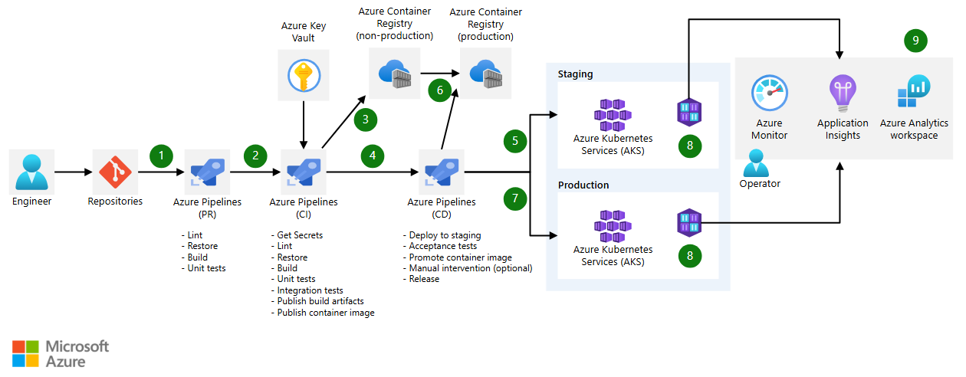
Microservice Azure DevOps CI/CD Process

Slide 22
Demonstration
Build App using CI
Deploy to AKS using CD
Notes:
Consider demoing the following:
Use the existing lab to create a CI pipeline in Github Actions to show off the matrix image build strategy being used. Talk about each stage in the build pipeline.
Walk through the entire pipeline explaining the steps.
Use the existing lab to create a CI pipeline in Github Actions to show off how the helm chart is used.
Walk through the entire pipeline explain some of the additional things that could be done make it more like a production quality pipeline.

Slide 23
Questions?

Slide 24
Lab Application Deployment to Kubernetes
Lab Description
Deploy the AKS Store Demo app to kubernetes
Notes:
Link to lab: https://labondemand.com/LabProfile/
##########

Slide 25
Optional Section

Slide 26
GitOps

Slide 27

GitOps For AKS
GitOps Concept | Understanding the concept of GitOps
Deployment | Overview of deployment flow using GitHub and basic steps to set up GitOps
Operators | Introduction of two operators: ArgoCD and Flux

Slide 28
What is GitOps
Improve developer productivity
Improve software delivery compliance
Increased collaboration in SDLC
Faster deployments
Declarative
Versioned and Immutable
Pull automatically
Continually reconcile
Notes:
https://opengitops.dev/#principles

Slide 29
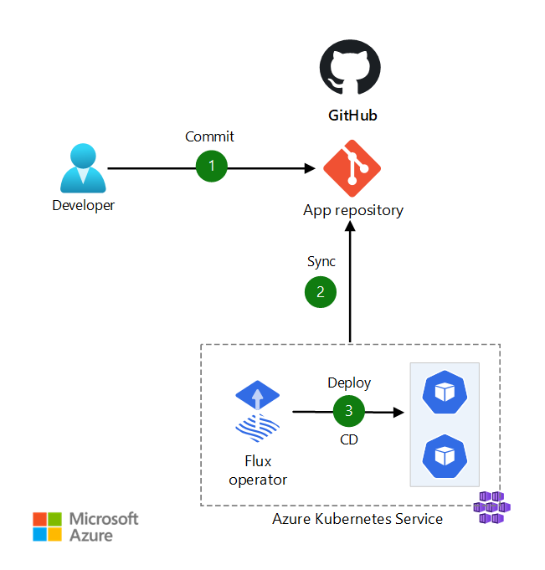
Deployments with Flux
Improve developer productivity
Improved software delivery compliance
Increased collaboration in SDLC
Faster deployments
Notes:
Set up Flux and GH Steps:
Install and Configure Flux Agent
- There options: aks cluster in azure GitOps feature, Install GH Flux using command line bootstraps in repo to AKS Cluste, azure CLI
- Configure Flux Agent to connect to the GH Repo/Branch which contains the deployment files and source code for the app
GH repo - The deployment files for app and infra, source code for app should be structured in the GH repo. The app customization and aks customization files should define the files path and names and etc. When the source code changed/pushed, GH Action CI should be triggered to build the source code and push the images to Container registry.
Flux Agent - Pull the deployment files from the GH repo to deploy the app automatically
Flux Controllers - A set of controllers are used in Flux agent.
- The customize controller and help controller
- Reflection: look up the images in the container registry
- Automation controller: deploy the image to the k8s

Slide 30
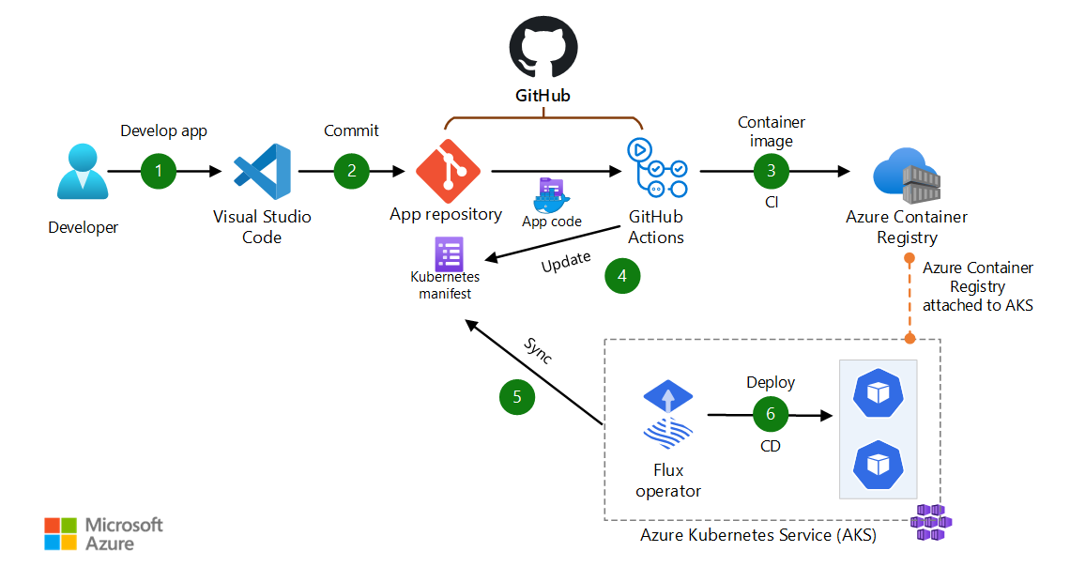
Deployments with GitHub, Flux and AKS
The app code is developed by using an IDE such as Visual Studio Code.
The app code is committed to a GitHub repository.
GitHub Actions builds a container image from the app code and pushes the container image to Azure Container Registry.
GitHub Actions updates a Kubernetes manifest deployment file with the current image version that's based on the version number of the container image in Azure Container Registry.
The Flux operator detects configuration drift in the Git repository and pulls the configuration changes.
Flux uses manifest files to deploy the app to the AKS cluster.
Notes:
Set up Flux and GH Steps:
Install and Configure Flux Agent
- Three options: aks cluster in azure GitOps feature, Install GH Flux using command line bootstraps in repo to AKS Cluste, azure CLI
- Configure Flux Agent to connect to the GH Repo/Branch which contains the deployment files and source code for the app
GH repo - The deployment files for app and infra, source code for app should be structured in the GH repo. The app customization and aks customization files should define the files path and names and etc. When the source code changed/pushed, GH Action CI should be triggered to build the source code and push the images to Container registry.
Flux Agent - Pull the deployment files from the GH repo to deploy the app automatically
Flux Controllers - A set of controllers are used in Flux agent.
- The customize controller and help controller
- Reflection: look up the images in the container registry
- Automation controller: deploy the image to the k8s

Slide 31
Deployments with ARGO
Improve developer productivity
Improved software delivery compliance
Increased collaboration in SDLC
Faster deployments
Notes:
Improve developer productivity
Argo CD provides developers with a self-service environment for application deployment. Software development teams can focus on creativity and writing business logic instead of time and energy on manual and remedial deployments.
2. Improved software delivery compliance
Allow your developers, Ops, and DevOps teams to use a single platform for infrastructure change management. Apply organizational policies to restrict access to Kubernetes resources and minimize your application downtime and outages.
3. Increased collaboration in SDLC
While working on Argo CD, every team member can work from the same system to achieve GitOps and understand the status of individual processes. The single Git repository fosters collaboration amongst team members by assigning tasks to individuals and deploying code from each person as necessary.
4. Faster deployments
Argo CD allows teams to perform more rapid deployments into Kubernetes clusters across multi-cloud. Quicker releases of application changes mean shorter time to market and more flexibility in responding to customer demand.
https://medium.com/@veerababu.narni232/a-complete-overview-of-argocd-with-a-practical-example-f4a9a8488cf9
https://techcommunity.microsoft.com/blog/azureinfrastructureblog/argocd-integration-with-private-aks-cluster/4313208

Slide 32
Deployments with ARGO, GitHub and AKS
The app code is developed by using an IDE such as Visual Studio Code.
The app code is committed to a GitHub repository.
GitHub Actions builds a container image from the app code and pushes the container image to Azure Container Registry.
GitHub Actions updates a Kubernetes manifest deployment file with the current image version that's based on the version number of the container image in Azure Container Registry.
Argo CD pulls from the Git repository.
Argo CD deploys the app to the AKS cluster.
Notes:
https://learn.microsoft.com/en-us/azure/architecture/example-scenario/gitops-aks/gitops-blueprint-aks

